Slide 1
COE Research Update
Arun Somani
Associate Dean for Research
College of Engineering

Slide 2
Research Update
Presidential Faculty Recruiting Initiatives
  Recruiting in three areas - Big Data (2), Translational Health (2), and Emerging needs (2)
Accelerating Collaborative Research (ACR) Initiative
  Funded three large proposals to start new directions
Increasing Graduate Student Enrollment Initiative
  Funded first year of 30 new graduate students
  In addition President's office funded 10 more
  Repeating the same for the coming year
Research funding for FY14 was $82+M
Industry collaboration effort is on

Slide 3
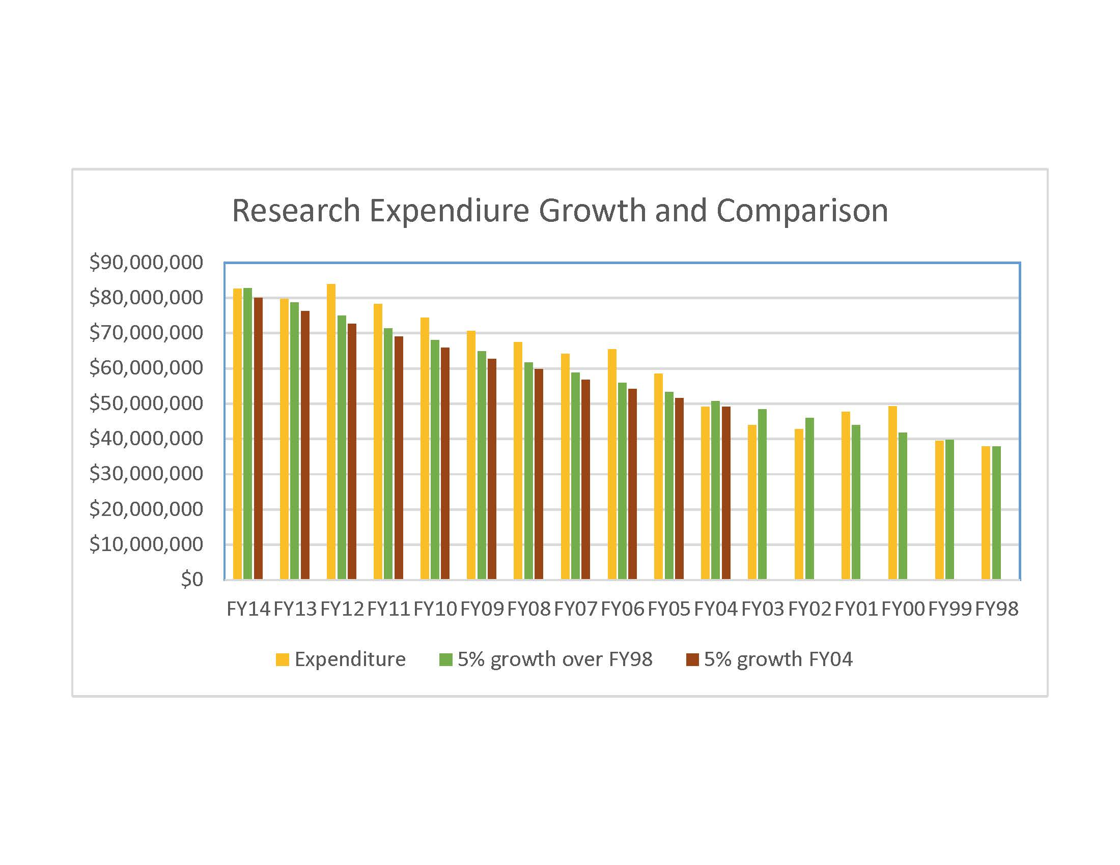
Research Expenditure
5% Sustainable Growth
  Sustained over FY99 (15 years)/FY04 (10 years) base

Slide 4
Recent ACRI Proposals Funded
Leading to Larger Research Activity (~$75K)
  Hui Hu: Icing Physics and Anti/De-icing Technology
  S. Subramaniam & R. Fox: Multiphase Flow Research
  Yue Wu: Advanced Thermal Technology
Pursuit Funding (~$30K)
  Anupam Sharma: Silent Propulsion Systems and Wind Turbines
  Umesh Vaidya: Network Controlled Dynamical Systems

Slide 5
Recent Large Proposals Funded
Theodore Heindel, IOWA EPSCOR: Harnessing Energy Flows in the Biosphere to Build Sustainable Energy Systems, NSF, $4.00M
Robert Brown, Bio-renewable Research Program, Exxon-Mobil, $1.00M
Brent Shanks, Engineering Research Center for Bio-renewable Chemicals (CBIRC), NSF, $2.83M (renewed)
Jacobson et.al. Information Assurance Scholarships, NSF, $2.30M
Cochran and Williams, Demonstration Scale Production of Bio-Based Thermo-plastic Elastomers, Argo Genesis, $1.16M
Cochran and Williams, Adhesive Pain and Coatings from Agrylated Glycerol, Argo Genesis, $1.00M
Peter Taylor, Strategic Highway Research Program II, $1.10M
Suresh Kothari, Ruler: A System to Detect Resource Usage Vulnerabilities within Software, AFRL-STAC, $4.65M (includes a $2.2M subcontract)
Manimaran Govindarasu, High-Fidelity, Scalable, Open-Access Cyber Security Test-bed for Accelerating Smart Grid Innovation, NSF, $0.99M
Pursuit Funding (~$30K)
  Anupam Sharma: Silent Propulsion Systems and Wind Turbines
  Umesh Vaidya: Network Controlled Dynamical Systems

Slide 6
Recent Large (Collaborative) Proposals
Robert Brown et.al., Agro-Ecosystems Approach to Sustainable Production via the Pyrolysis Biochar Platform, USDA, $5.00M.
Liang Dong et.al. , Transgenic Approaches in Managing Sudden Death Syndrome in Soybean, USDA, $1.07M.
Joann V O'Donnell (CIRUS), Iowa Center for Industrial Research and Service, Doc National Institute, $1.86M.
Monica Lamm et. al., Tec-STEM Partnership, NSF, $2.93M.
Suresh Kothari, Ruler: A System to Detect Resource Usage Vulnerabilities within Software, AFRL-STAC, $4.65M (includes a $2.2M subcontract).
Manimaran Govindarasu, High-Fidelity, Scalable, Open-Access Cyber Security Test-bed for Accelerating Smart Grid Innovation and Development, NSF, $0.99M.
Tien Nguyen, Collaborative Research: Exploiting the Naturalness of Software, NSF, Total $2.60M, ISU: $0.50M.

Slide 7
Industry Research
PI’s Guide to the Contracting Process for Industry Sponsors
Flexible Solutions: Brief Description
  Option A: the traditional university model – IP stays with ISU.
  Option B: a pre-paid option to an exclusive license with pre-set terms.
    Fee: 0% of the total cost of the project (with a minimum of $15,000)
    Standard royalty rate of 1% when sales exceed $20M/year.
    Created some flexibility for the minimum fee
  Option C: Intellectual property ownership. A 75% fee of the project cost.
Developed a new standard solution
  No anticipated intellectual property

Slide 8
CoE Research Thrusts
Thrust | Faculty Point of Contact | Current Funding
Bio-renewables | Robert Brown (ME), Brent Shanks (CBE) | DoE, NSF, USDA, Industry
Composite Materials | Nicola Bowler (MSE) | NSF, Industry
Cyber Security | Doug Jacobson, Joe Zambreno, ERI | DARPA, NSF, Industry
Digital Manufacturing | Janis Terpenny (IMSE) | DMDI/UI Labs, NSF, Industry
Machine Automation | Matt Darr (ABE) | John Deere, NSF
Translational Health | Balaji Narasimhan (CBE) | Presidential Initiative, DoD
Non-Destructive Evaluation | Leonard Bond (AE) | Industry Consortium, AFRL
Wind Energy | Sri Sritharan (CCEE), ERI | NSF, DoE

Slide 9
Engineering Research Institute
Primary Purpose:
Work with CoE faculty to increase and diversify CoE research portfolio
Key Services:
  – Surface Federal and Industry funding opportunities
  – Engage faculty in developing compelling proposals
  – Lead and manage large, multi-disciplinary efforts: Provide pre- award, post-award and project management services if requested.
  – Work with Strategic Initiative Leaders to establish new Centers of Excellence
  – Provide College-level research administration, e.g., research expenditures data collection and analysis, support and coordination for limited submission competitions, etc.

Slide 10
Graduate Program
Lowest PhD/faculty ratio in USNews ranked schools
We reviewed our capacity.
4 PhD/tenured and 2 PhD/untenured faculty, suggest that COE should have 750 students (~3.5/faculty)
That is our goal for PhD program size (currently ~600)
Recruiting URM students and women is priority
We are aggressively pursuing the goal
Bridge funding and insurance program to manage risk
Recruiting is progressing well
We expect another 375 MS and 125 Meng student

Slide 11
Sourabh Bhattacharya
Assistant Professor, Iowa State University (Email: sbhattac@iastate.edu)
Research Focus
Security in networked control systems against adversarial attacks.
Vision-based persistent surveillance and monitoring using autonomous vehicular networks.
Data deluge in sensor-actuator networks.
Cyber penetration and autonomy in precision agriculture.
Capabilities
Resilient motion planning and control techniques for autonomous vehicular networks.
Efficient resource-allocation techniques for mutirobot teams engaged in surveillance applications.
Vision based control of mobile robots at low data rates in information rich environments.
Path planning and control of autonomous vehicles in semi-structured environments.
Significant Results
Design and development of computationally efficient algorithms for autonomy with performance guarantees in mobile surveillance applications.
Design and development of joint control, estimation and acquisition techniques for sparse signal acquisition without recovery.
Current Projects
Federal Funding: Iowa State Research Initiation Funds, NSF, AFOSR, DTRA (pending)
Industry collaborations: John Deere (technical expertise exchange)
ISU Proprietary

Slide 12

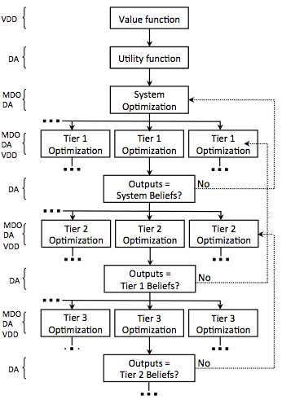
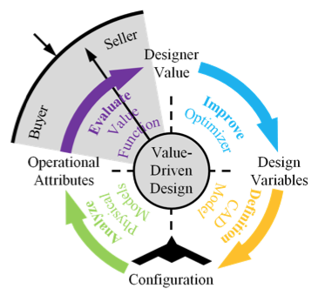
Value-based System Engineering - A new approach for achieving rigorous system consistency: Christina L. Bloebaum
Dennis and Rebecca Muilenburg Professor of Aerospace Engineering, Iowa State University (Email: bloebaum@iastate.edu)
Research Focus
Instill a rigorous basis for decision-making in design of complex engineered systems
Apply to both industrial and military applications
Draw upon foundations from: Multidisciplinary Design Optimization (MDO), Probability Theory, Decision Analysis (DA), Value-Driven Design (VDD), Organization Design (OD)
Capabilities
Ensure system consistency in:
  system preference (represent what is really wanted and resolve/align different preferences between organizations)
  system physics (ensure all necessary couplings at appropriate fidelities in all design stages)
  risk preference (propagate stakeholder risk attitude throughout organization to reduce risk bias)
  organization structure (align process and product structure to support information flow/coupling capture)
Value-based SE Approach
Significant Results
Requirements unnecessarily limit design space and lead to suboptimal system designs
Value-based SE enables informed trade explorations and reduces cost and time overruns
Aligning organization and product structure results in greater system value (i.e. NPP)
Current Projects
A Value Driven System Engineering Acquisition Approach Using Cooperative and Bargaining Models (NSF, pending)
Visual Analytics for Creation of Value Functions in Complex Systems Design Under Uncertainty (NSF, awarded)
Organizational and Uncertainty impacts of Couplings in a System Design Framework (NSF, awarded)
Exploration of Multidisciplinary Couplings and Coupling Strengths to Mitigate Unintended Behaviors: Ares I Thrust Oscillation (NASA Marshall, awarded)
VDD with Bargaining
DA better aligns preferences for improved system design
MDO in VDD improves system value and system design
ISU Proprietary

Slide 13


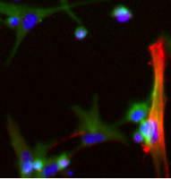
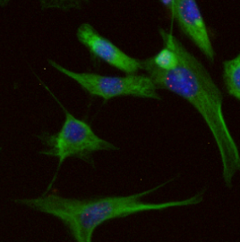
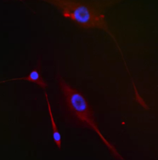

Instructive Substrates for Fibroblast and Macrophage Responses
Katie Bratlie, Materials Science & Engineering, Chemical & Biological Engineering
Research Focus
Develop novel materials that alter macrophage and fibroblast responses for tissue engineering and drug delivery applications
Approach
We work at the interface between materials chemistry and immunology to design platforms that modulate the immune system for disease treatment and prevention
Materials
Chemically modified synthetic and naturally-derived hydrogels
Altering Macrophage Polarization
Altering Collagen Orientation
Selected publications
Bygd et al. Clinical and Translational Medicine accepted.
Akilbekova, et al. Journal of Biomedical Materials Research Part A 103A, 262 (2015)
Wang et al. Biomacromolecules 15, 4102 (2014)
Ma et al. Advanced Healthcare Materials DOI: 10.1002/adhm.201200341 (2013)
Bratlie et al. Advanced Healthcare Materials 1, 267 (2012)
Ma et al. Advanced Materials 23, H189 (2011)
Dang et al. Biomaterials 32, 4464 (2011)
Liu et al. Biomaterials 32, 1796 (2011)
Bratlie et al. PLoS ONE 5, e10032 (2010)
Dang et al. Biomaterials 30, 6896 (2009)
Modification 5
Modification 15
Glass Coverslip
Current Funding: NSF, Roy J. Carver Charitable Trust
Contact Info: (515) 294-7304, kbratlie@iastate.edu

Slide 14
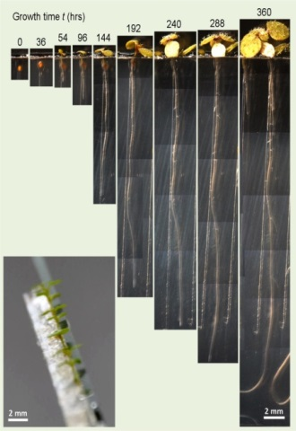
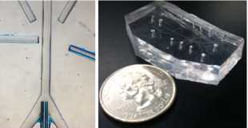
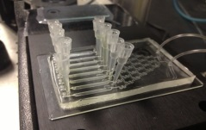
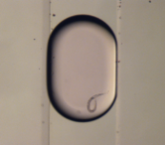

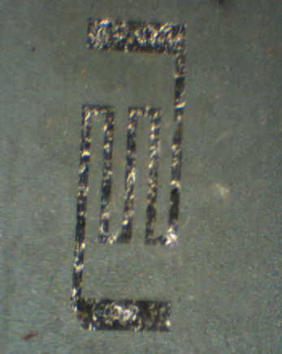
Professor Liang Dong
Associate Professor, Iowa State University (Email: ldong@iastate.edu)
Research Focus
Biochips for high-throughput drug screening (HTS)
Bioinstrumentation for HTS plant phenotyping
Miniature sensors for detection of plant and soil nutrients
Miniature sensors for structural health monitoring
Capabilities
Integrated microsystems approach
Controllable microenvironment
High throughput, high spatial and temporal resolution, and high sensitivity
Real-time monitoring
Batch fabrication and potentially low cost
Current Projects
Federal Funding: NSF, USDA, NIH
State Funding: Iowa DOT
Internal Funding: Plant Sciences Institute
Industry collaborations: Iowa Corn Promotion Board
Significant Results
ISU Proprietary

Slide 15
Professor Sarah Ryan
Industrial and Manufacturing Systems Engineering, Iowa State University (smryan@iastate.edu)
Research Focus
Day-ahead scheduling of thermal electricity generating units
  On/off status
  High penetration of renewable generation
  Imperfect forecast of demand
Capabilities
Probabilistic scenarios for demand and renewable generation
Solution algorithm considers all scenarios simultaneously in parallel computation
Current Projects
Federal Funding
  U.S. Department of Energy ARPA-E
Industry collaborations
  Alstom
  Independent System Operator of New England
Significant Results
Implicit reserve capacity in solution adapts to the level of uncertainty
Cost savings of 1-2% relative to fixed reserves currently in use
ISU Proprietary

Slide 16
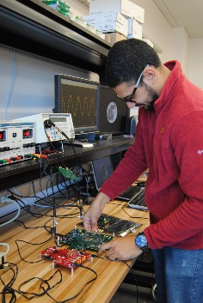
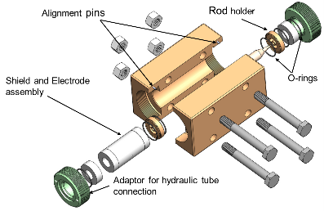
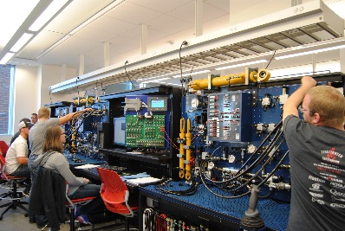
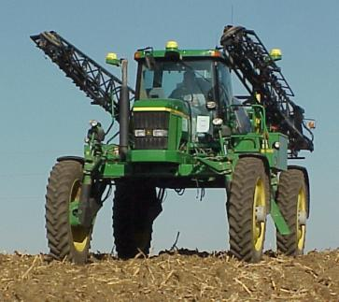
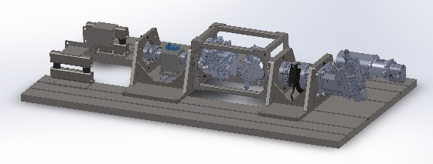
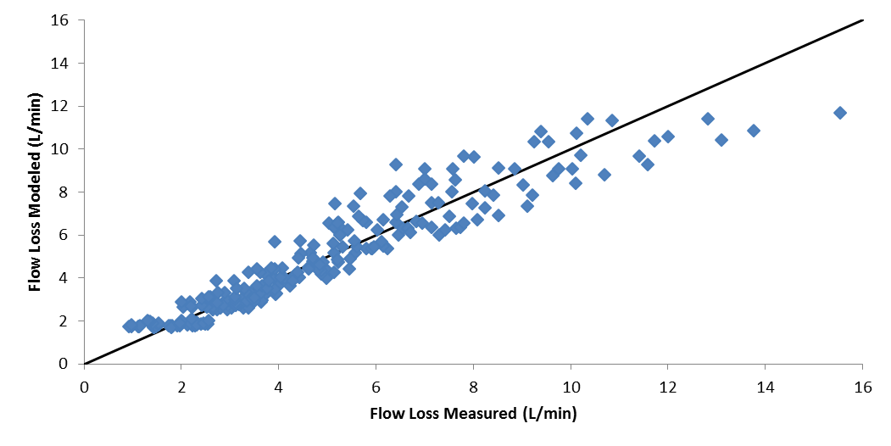
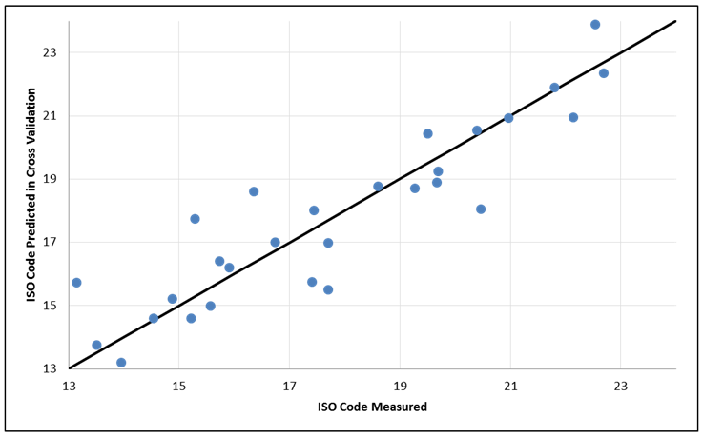
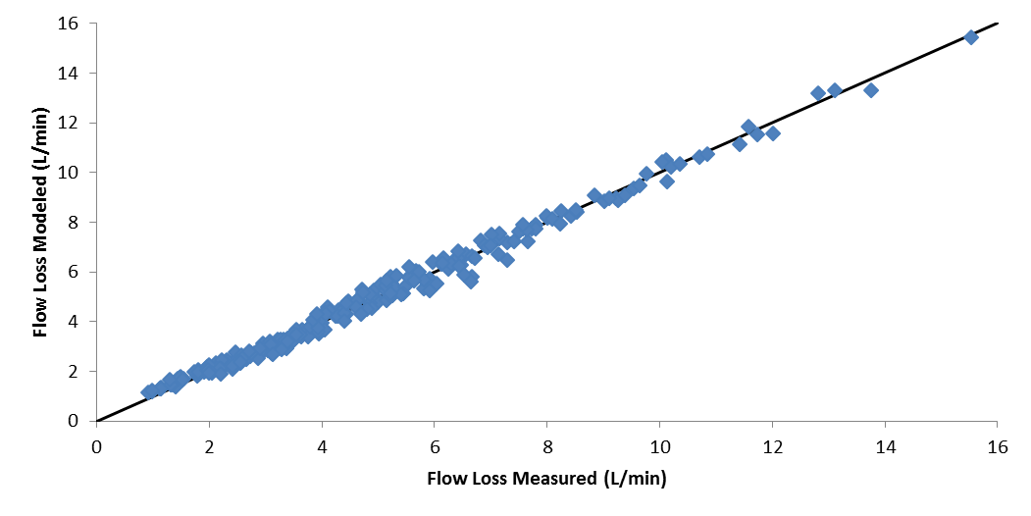
Brian L. Steward
Professor of Agricultural and Biosystems Engineering, Iowa State University (Email: bsteward@iastate.edu)
Research Focus
Dynamic systems and sensing for agriculture and biosystems
Fluid power – hydraulics and pneumatics
Precision agriculture
Automation and mechatronics at the interface of machine and environment.
Capabilities
Danfoss Fluid Power Lab
Danfoss Agricultural Sensing and Mechatronics Lab
Vehicle Power Systems Lab
Agricultural Engineering Agronomy Research Farm
Biocentury Research Farm
Transmission Dynamometer
Dielectric Contaminant Sensor
Significant Results
Current Projects
Shielding Cucurbit Crops for Resilient Agroecosystems – USDA SCRI
Developing robotic technologies for in-situ automated intra-row weed control for vegetable production systems – USDA AFRI
Wind velocity effects on spray drift potential – AGCO
Dielectric Spectroscopic Sensor Development for Hydraulic Fluid Contaminant Detection –NFPA
Development of a Design Tool for Hydraulic Cylinder Cushions – Seabee Corp.
Virtual Operator Model – Deere
Full Jeong Model
Full Ivantysyn and Ivantysynova Model
Prediction of iron powder contamination from dielectric sensor
Pump Flow Loss
Model Results
ISU Proprietary

Slide 17
Professor Wenzhen Li
Richard Seagrave Associate Professor of Chemical Engineering, Iowa State University (Email: wzli@iastate.edu)
Research Focus
Develop next generation electro-catalysts and electrochemical systems for advancing science and technologies important to Energy and Sustainability needs
Capabilities
Integrate electrocatalysis and electrochemistry with biomass / biorenewables for fuels, chemicals and electrical energy generation
Design and prepare advanced non-precious metal and metal-free electrocatalysts for fuel cells and electrolytic cells
Significant Results
Achieved efficient electrocatalytic hydrogenation of furfural to methylfuran biofuel using non-precious metal electrodes with nanostructured surface
Developed high performance biomass fuel cells with crude biorefinery & pyrolytic feedstock fuels
Current Projects
Federal Funding: NSF CBET-1159448 Selective Electrocatalytic Oxidation of Polyols
NSF CBET-1235982 Electrocatalytic Reduction of CO₂ to Hydrocarbon Fuels
ISU Proprietary

Slide 18
Quad Chart CEER: David J. White
R. L. Handy Professor of Civil Engineering, Iowa State University (Email: djwhite@iastate.edu)
Research Focus
Advanced Earthwork Engineering Technologies for Infrastructure
Capabilities
Center fro Earthworks Engineering Research (CEER) @ InTrans: Multidisciplinary team approach to problem solving
$850k Geotechnical Mobile Laboratory
Significant Results
Developing national standards for automated machine guidance and intelligent compaction technologies
Research and technology transfer conducted in 25 states
Current Projects
U.S. DOT funded project to develop national guide for Concrete Pavement Foundation Design and Construction
Caterpillar, Inc. partnership to study autonomous and robotics construction of infrastructure
ISU Proprietary

