Slide 1
The Engineering Student Council of Iowa State University
General Meeting - September 25th, 2023
Key Topics:
Trademark
Allocations

Slide 2
Agenda
Yamille Perez, Engineering Outreach
Quick PSA
ESC Updates
Including trademark and allocations
Club Updates
Questions
Events

Slide 3
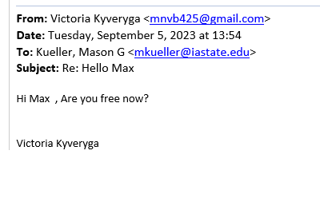
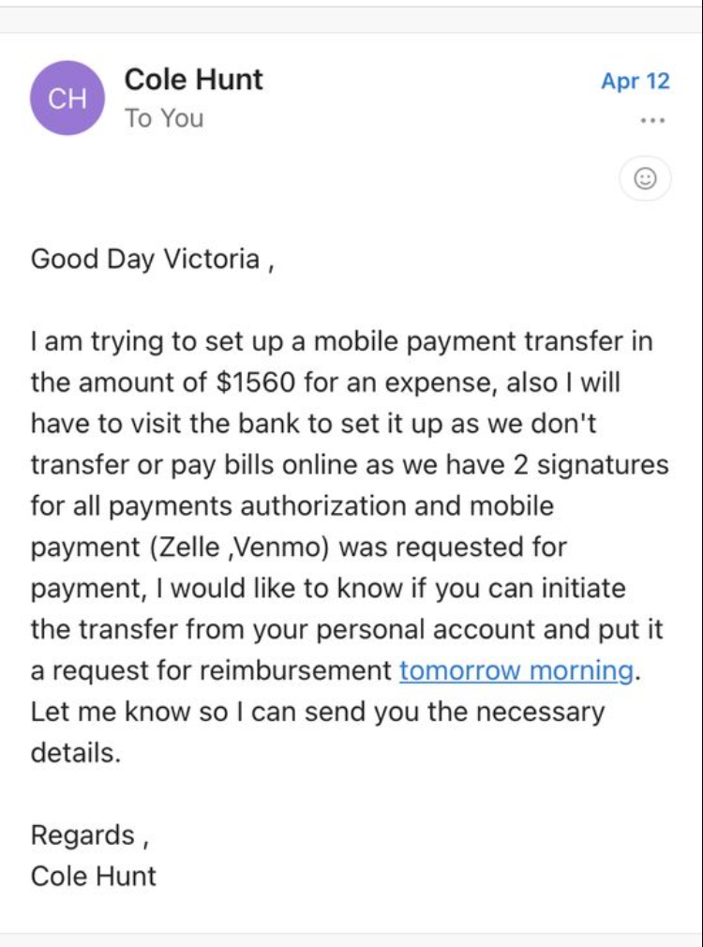
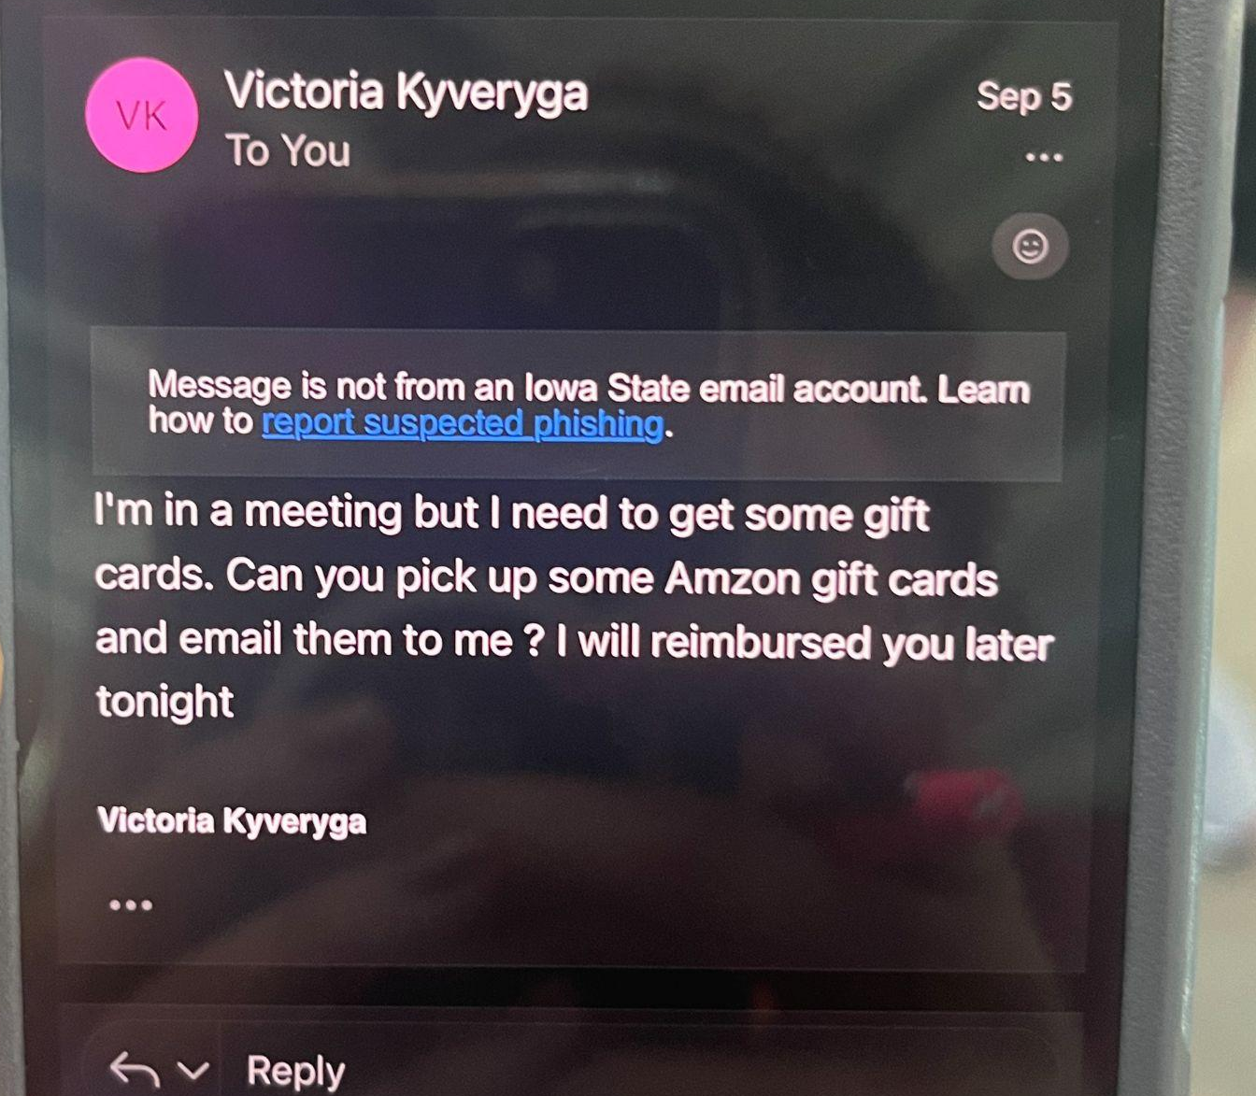
Avoiding phishing scams- indications
Misspelled words or incorrect grammar
Unfamiliar emails, non-iastate.edu emails
Requests for gift cards
Requests to Venmo/Zelle
Phishing scams are getting dangerously good! If in doubt, double-check by sending us a teams message or text.

Slide 4
Engineering Student Council Updates

Slide 5
Updates:

Slide 6
VP of Administration
Tanvi Mehetre
isu.esc.admi@gmail.com/ tanvim@iastate.edu
Updating ESC Listserv.
https://www.engineering.iastate.edu/esc/clubs/
Update the executive members contact information to receive emails on time
Filling out Trademark form requests

Slide 7
VP of Administration
Trademark
Tanvi Mehetre
isu.esc.admi@gmail.com/ tanvim@iastate.edu
3 Levels of Sponsorship (determined by SAC):
Sponsored
Affiliated
Registered/Campus Organization
Acceptable marks for each tier are found at: https://www.trademark.iastate.edu/files/documents/2021-11/GUIDELINES%20FOR%20STUDENT%20AND%20CAMPUS%20ORGANIZATIONS%20USE%20OF%20IOWA%20STATE%20UNIVERSITY%E2%80%99S%20TRADEMARKS.pdf
Apparel requires ® symbol
Merchandise/other requires ™ symbol
Sponsorship Form
Trademark Request Form
isu.esc.president@gmail.com for any questionse

Slide 8
VP of Finance
Allocation Process Refresher
Garrett Hein
Fill out these TWO forms by OCTOBER 2nd, 2023
ESC Fall 2023 Training Quiz (Quiz 1/2)
ESC Fall 2023 Funding Requests (Quiz 2/2)
Submit number of expenditures to total allocation from ESC (next slide)
Multiple forms can be submitted, but nothing less than 100.00 or to full ESC allocation amount
Forms submitted to joelj@iastate.edu
Critical forms are accurate and only list expenditures that are cleared and approved in workday
Please select larger expenditures to assist with less processing.
Goal is to equal ESC allocation to total expenditure amount
No funds are transferred from college to student organizations student.
Expenditures are removed from student organizational account and applied to COE designated account as designated by treasurer
The transactions listed on the form will be taken off of your account and put into an account under the Dean of the College of Engineering.

Slide 9
ALLOCATION IMPORTANT DATES
Allocations Open: NOW
(1) Presentations/Worksheets and Training Due: October 2nd, 2023
NEW this year: in-person allocations meetings are optional.
Holding Office Hours Thursday September 28th 11:00am-2:00pm Parks Library 0130b
Email gmhein@iastate.edu
Allocation Priority Reimbursement Request: December 17th, 2023
Allocation Reimbursement Request - LATEST Submission: January 26th, 2024
~$37,500 to Allocate to Clubs for the Fall 2023 Semester

Slide 10
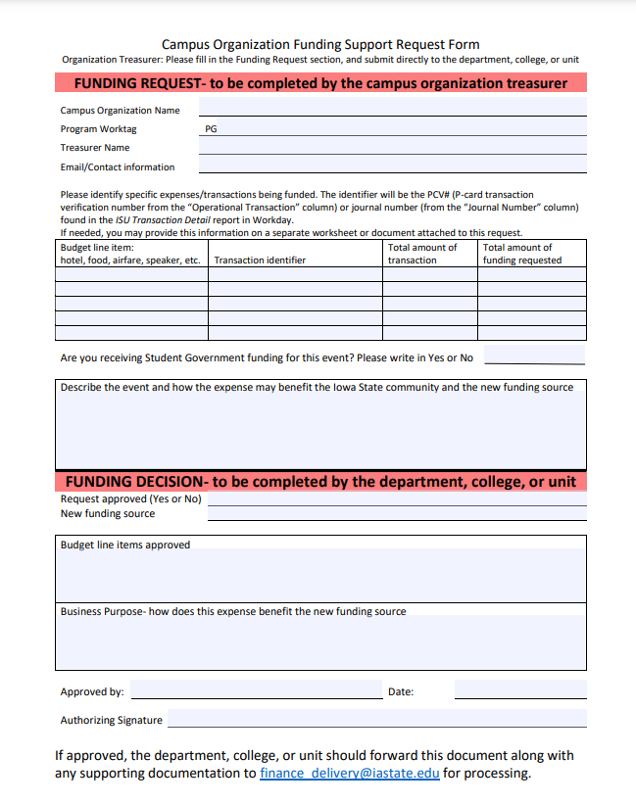
NEW form this year to claim reimbursement for club expenses
Campus Organization Funding Support Request Form
Allocation Priority Reimbursement Request: December 17th, 2023
Allocation Reimbursement Request - LATEST Submission: January 26th, 2024

Slide 11
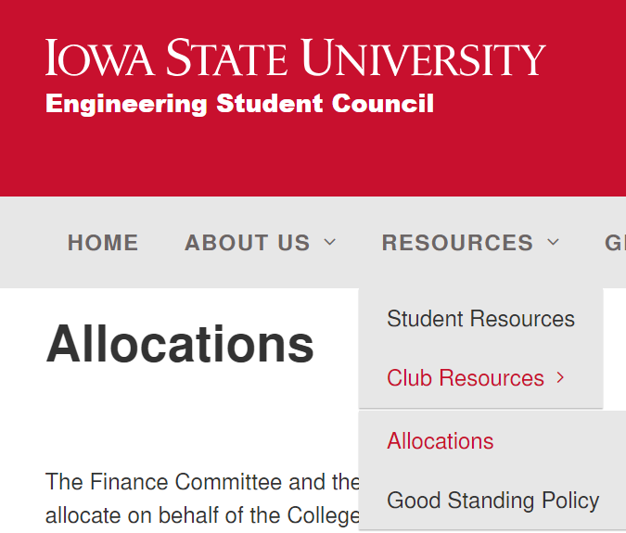
Everything is also on the ESC website, but we will send out these slides containing all links after the meeting. Allocations tab on the ESC website

Slide 12
VP of Communication
Abigail Stanlick
stanlick@iastate.edu
isu.esc.communication@gmail.com
Instagram: @esciowastate
If you have a club event that you would like to promote on the ESC Instagram, send a DM and we may be able to help!
Please include your club socials on the company interest form (link and QR code in 2 slides)

Slide 13
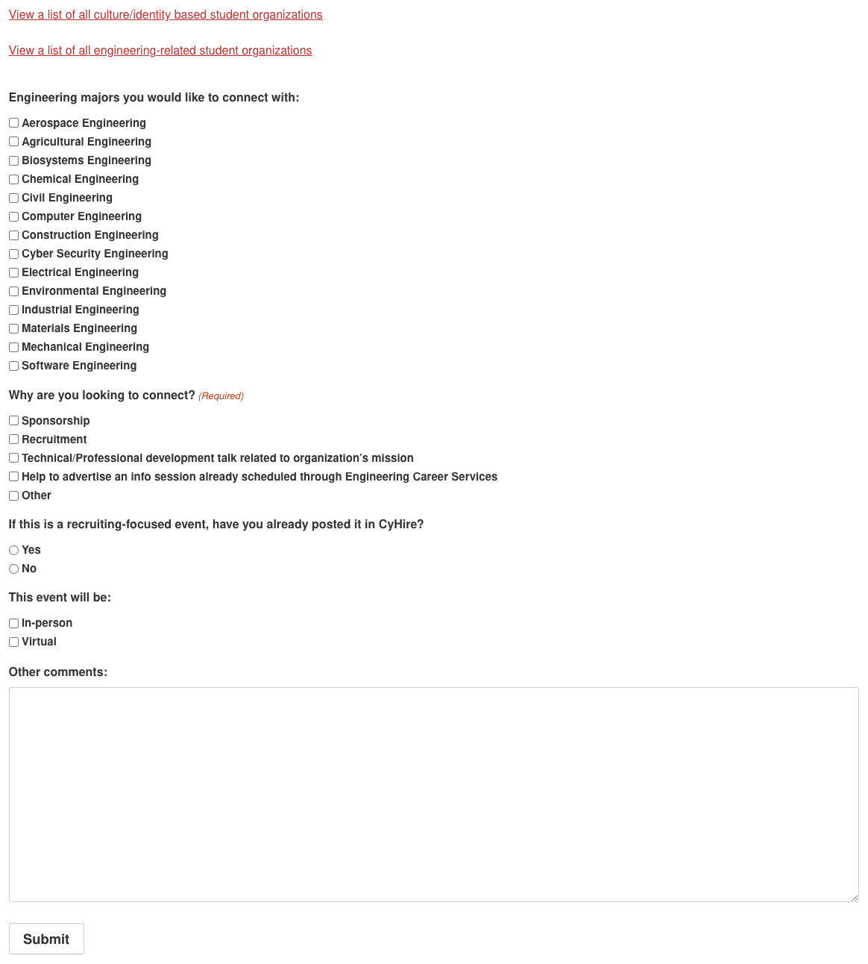
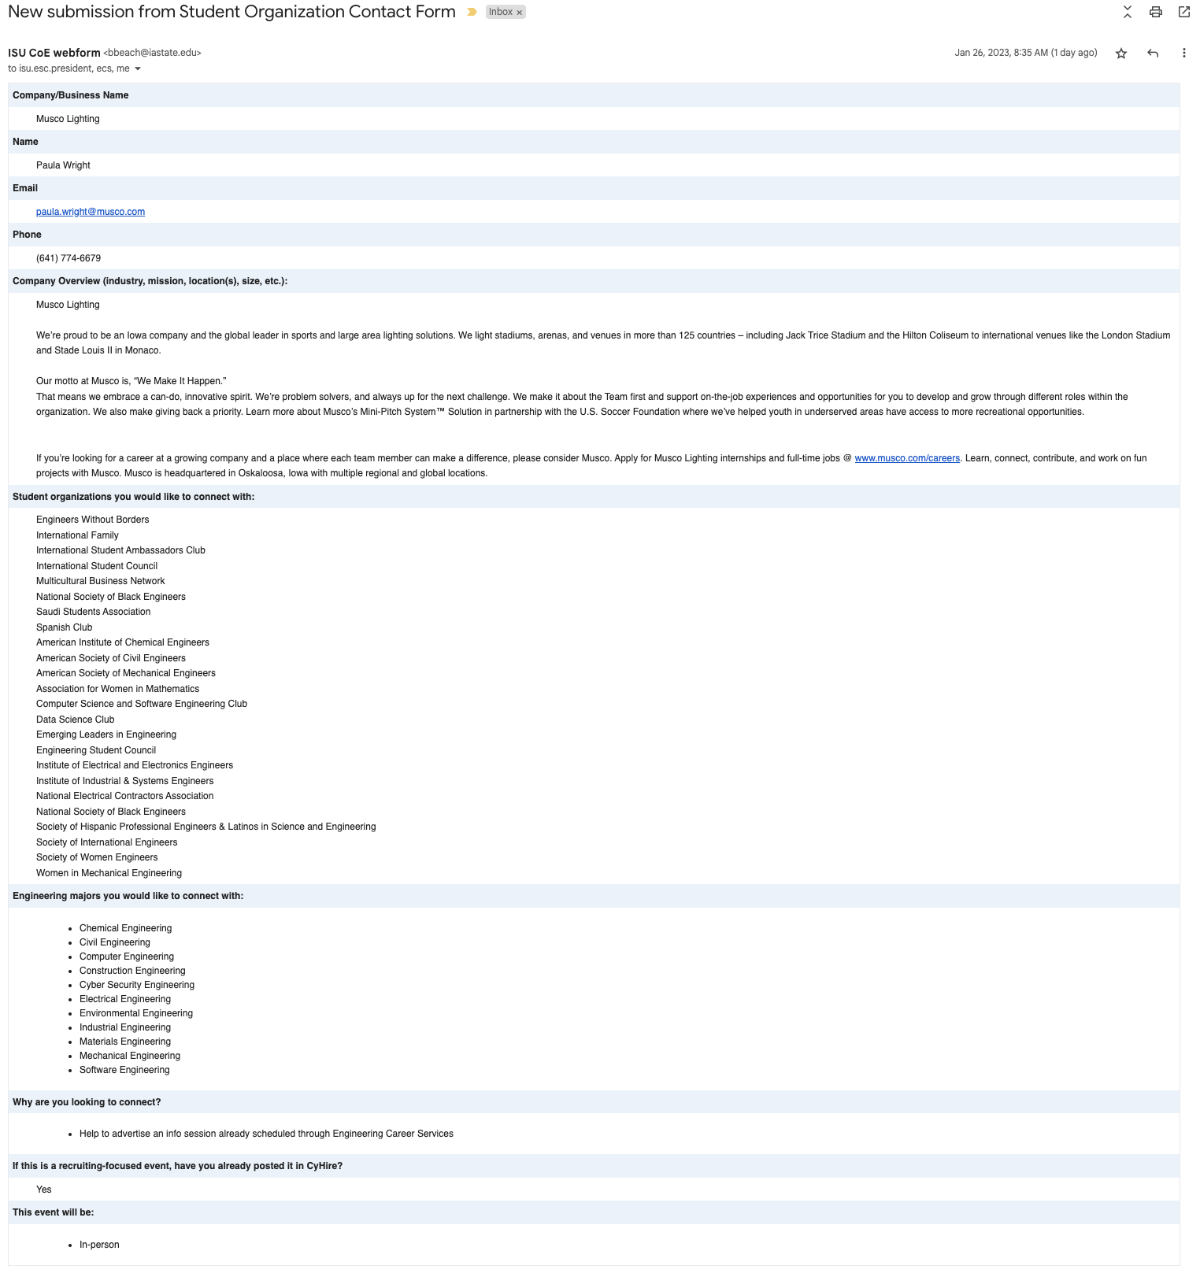
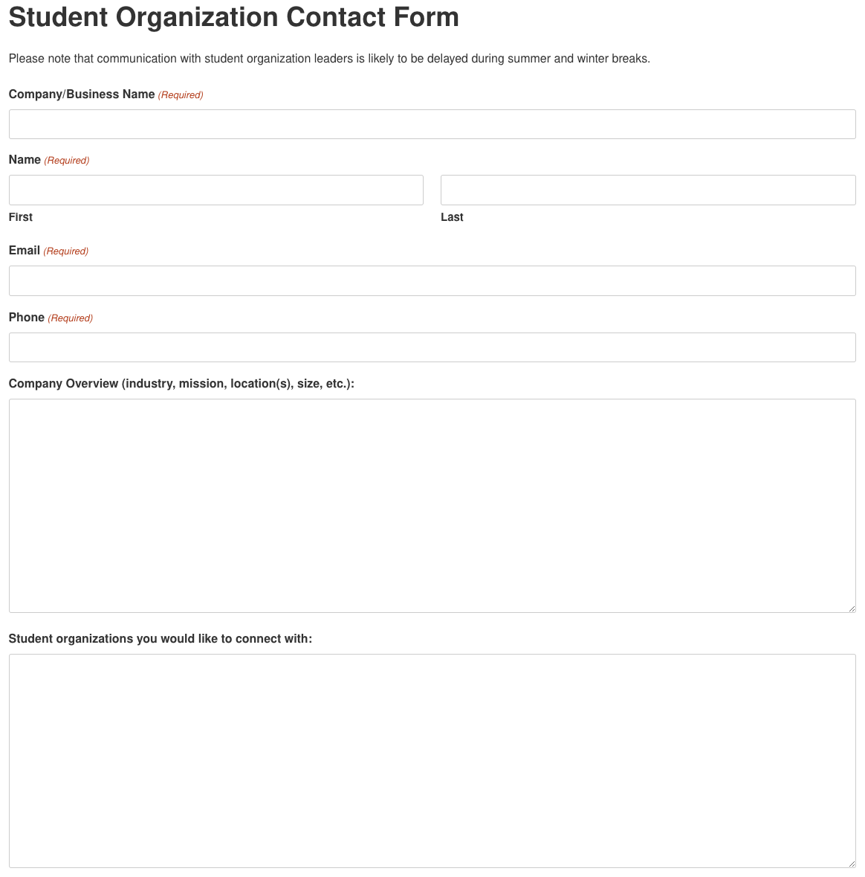
This is the form that companies fill out to connect with student orgs
This is the info that gets sent to you about the company

Slide 14
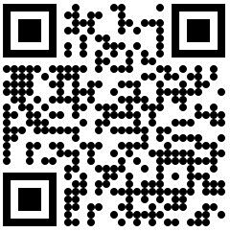
Employer-Club Outreach Form
Employers fill out form (see previous slide)
We send emails to you guys
You reply quickly to the employers (a lot of them are trying to recruit 👀)
Fill out this form to receive information about
employer interest!
(last question asks for social platforms and usernames)
https://forms.gle/S5eGdzz6BNwxs73bA

Slide 15
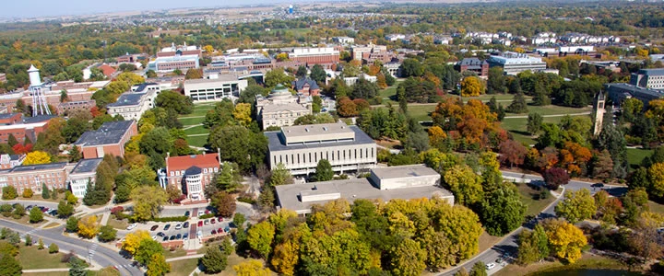
VP of Student Affairs
Stephen Peterson
sjp22308@iastate.edu
Projects:
Dean Meet & Greet
Feedback for ESC/Deans
Supporting Engineering Professionals & Pizza

Slide 16
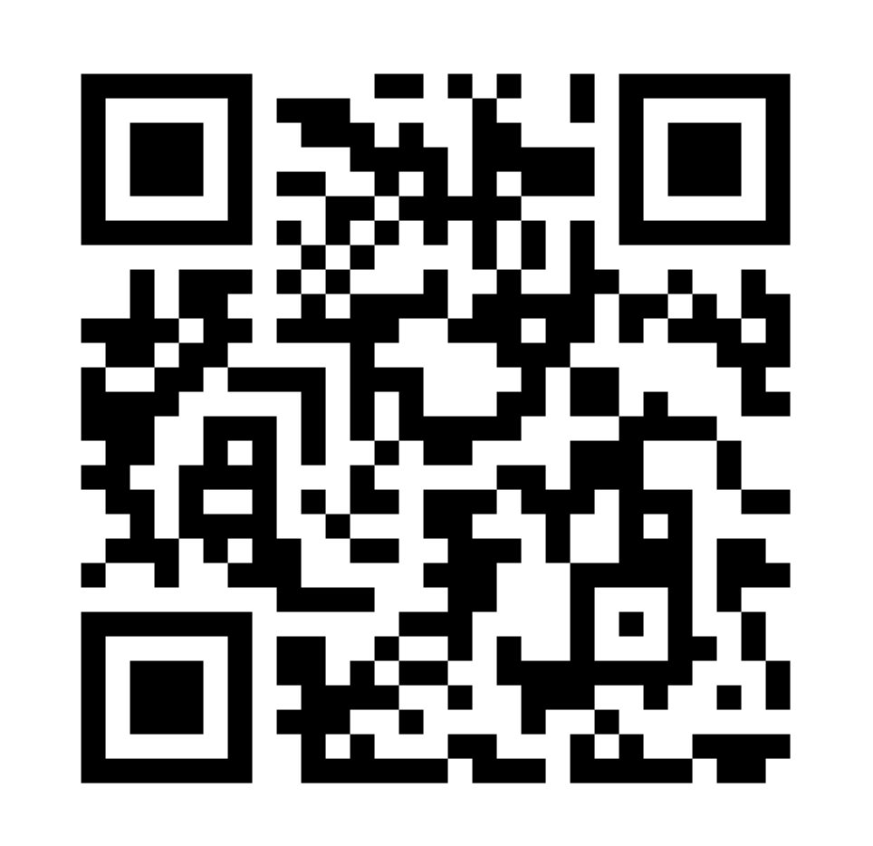
VP of Events
Soren Hellyer & Charan Gurramkonda
shellyer@iastate.edu & charang@iastate.edu
Engineering Club Fest (Oct.4 ] 5:00-7:30pm | West Marston Lawn)
**Setup Time - 4:00pm**
TO DOs for Clubs - Google Form
Other Events:
Donuts W/ The Dean (PENDING)
Order Of The Engineering (PENDING)
Dead Week Breakfast (PENDING)

Slide 17
First-Year Leaders in Engineering (FLiE)
Matthew Iehl & Analyn Seeman
miehl@iastate.edu & aseeman@iastate.edu
Had our first meeting last week
Will have elections for positions next week
Still accepting members

Slide 18
Engineers’ Week
Blake Gleason & Julia Bigari
isueweek@gmail.com
Had a great golf tournament!
Will be assisting with DE on October 4th
Planning Pi-Mile run for October 22nd
Trivia night early November
Lego Building Competition late November

Slide 19
VP of Outreach
Matthew Brown
isu.esc.outreach@gmail.com
Set up meetings with important individuals related to ISU outreach
Next steps will be known after the meetings have occurred

Slide 20
Student Government

Slide 21
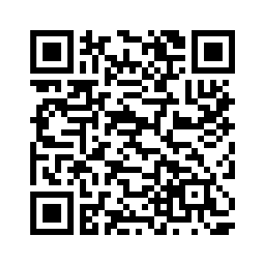
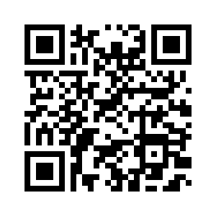
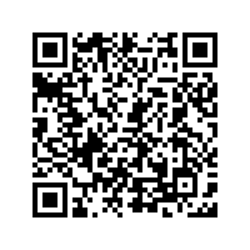
Senate Updates - Max
Anna Hackbarth Open Max Kueller Caden Klopfenstein | <annah2@iastate.edu > <mkueller@iastate.edu> <cklop@iastate.edu>
Safe App (App Store)
Cyclone Support
Health and Wellness Student Leadership Board
Party Smart
ISUPD Advisory Board
Iowa State Safe App
Friend Walk
Social Escape
Future ISUPD meetings
Cyclone Support
What it is
Getting it to students
Safe App (Play Store)

Slide 22
Senate Updates - Anna
Anna Hackbarth Open Max Kueller Caden Klopfenstein | <annah2@iastate.edu > <mkueller@iastate.edu> <cklop@iastate.edu>
Elected as Speaker of the Senate
Written confirmation bills for various directors, senators, and other vacancies
Bylaw bill up for vote this week
Bylaw and governing document review started

Slide 23
Senate Updates - Caden
Anna Hackbarth Open Max Kueller Caden Klopfenstein | <annah2@iastate.edu > <mkueller@iastate.edu> <cklop@iastate.edu>
Confirmed as a Senator in early September
Confirmed to the Sustainability Committee
Gathering and connecting ideas from sustainable clubs
Reduction of plastic waste from dining centers
Implementing Cyclone Support in Residence Halls
Spreading awareness of Student Government

Slide 24
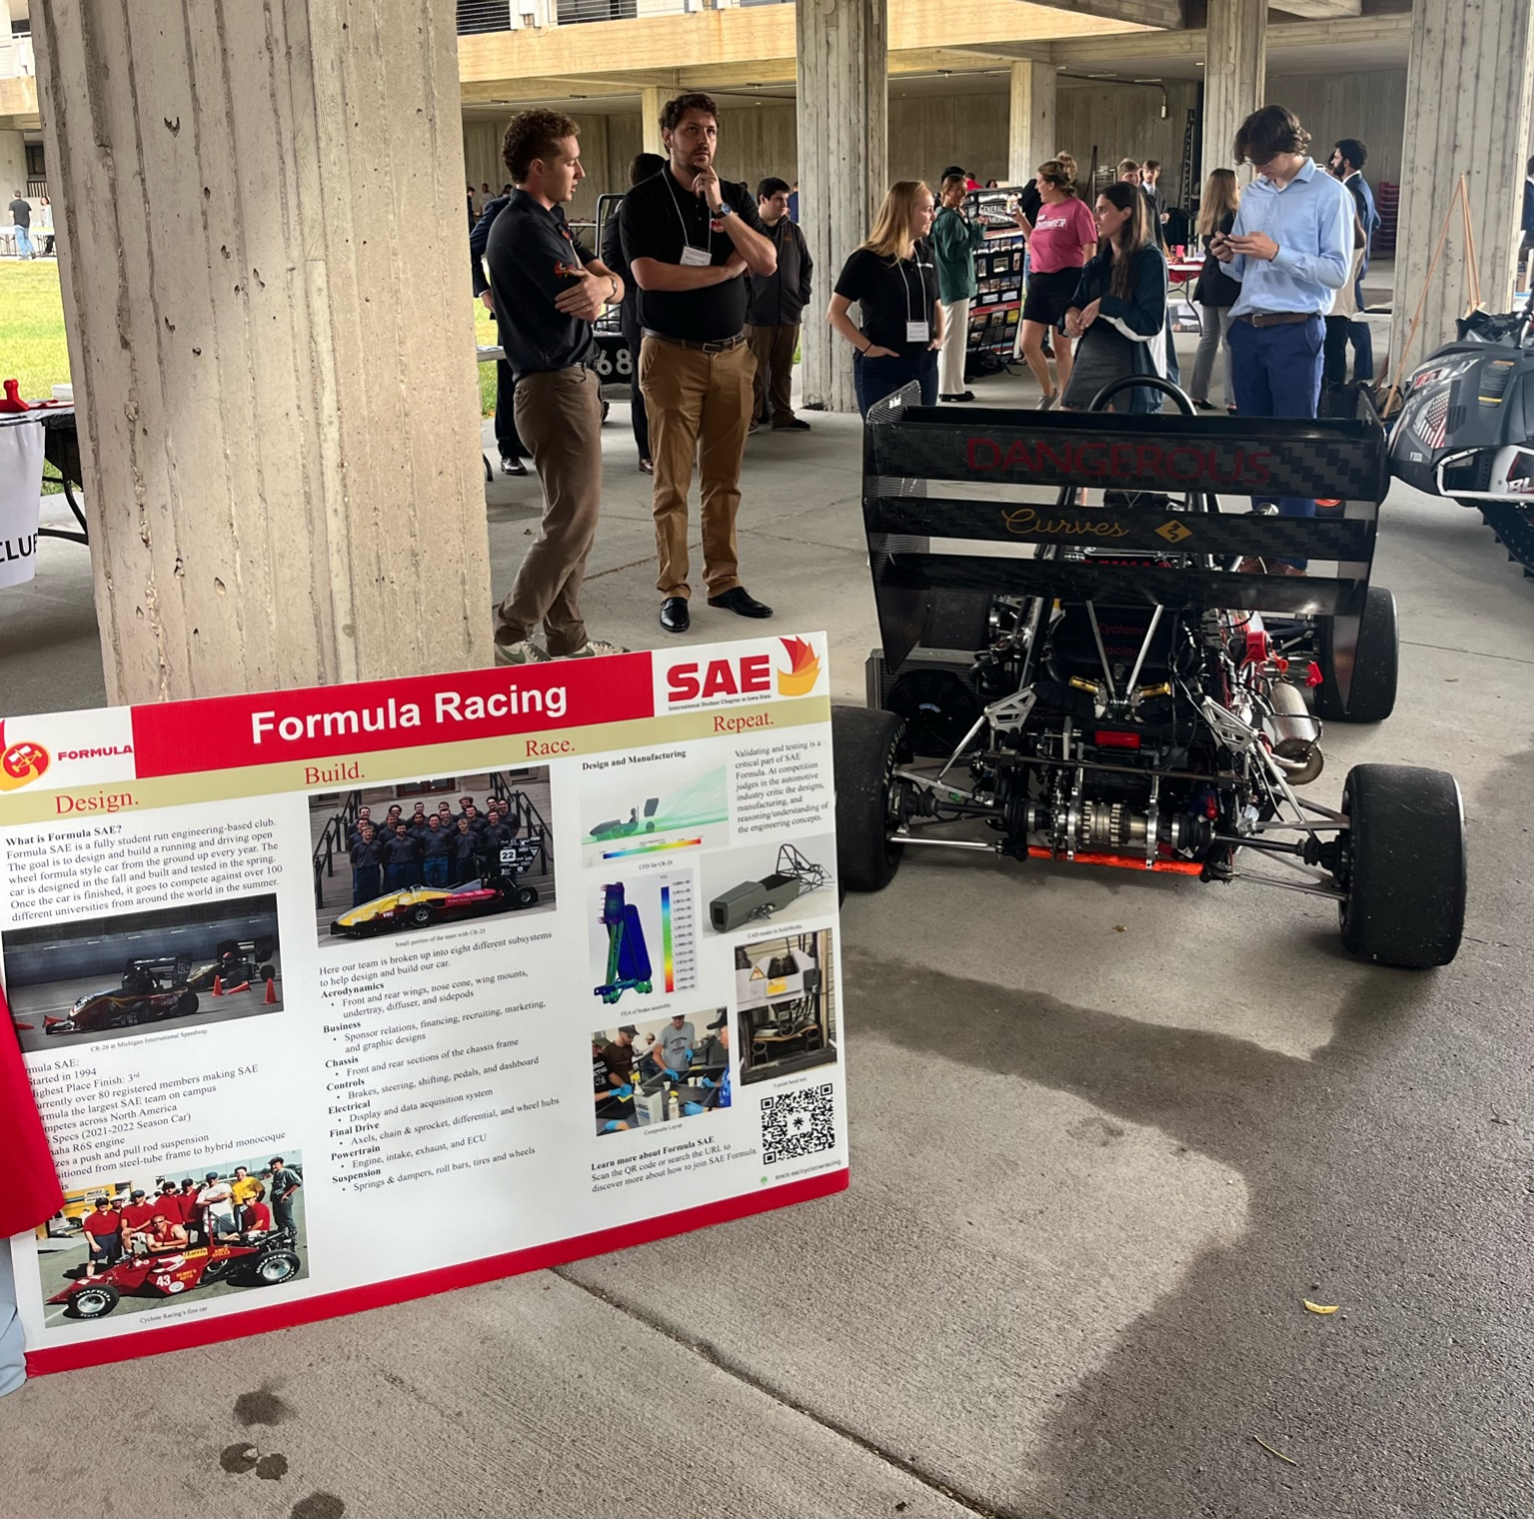
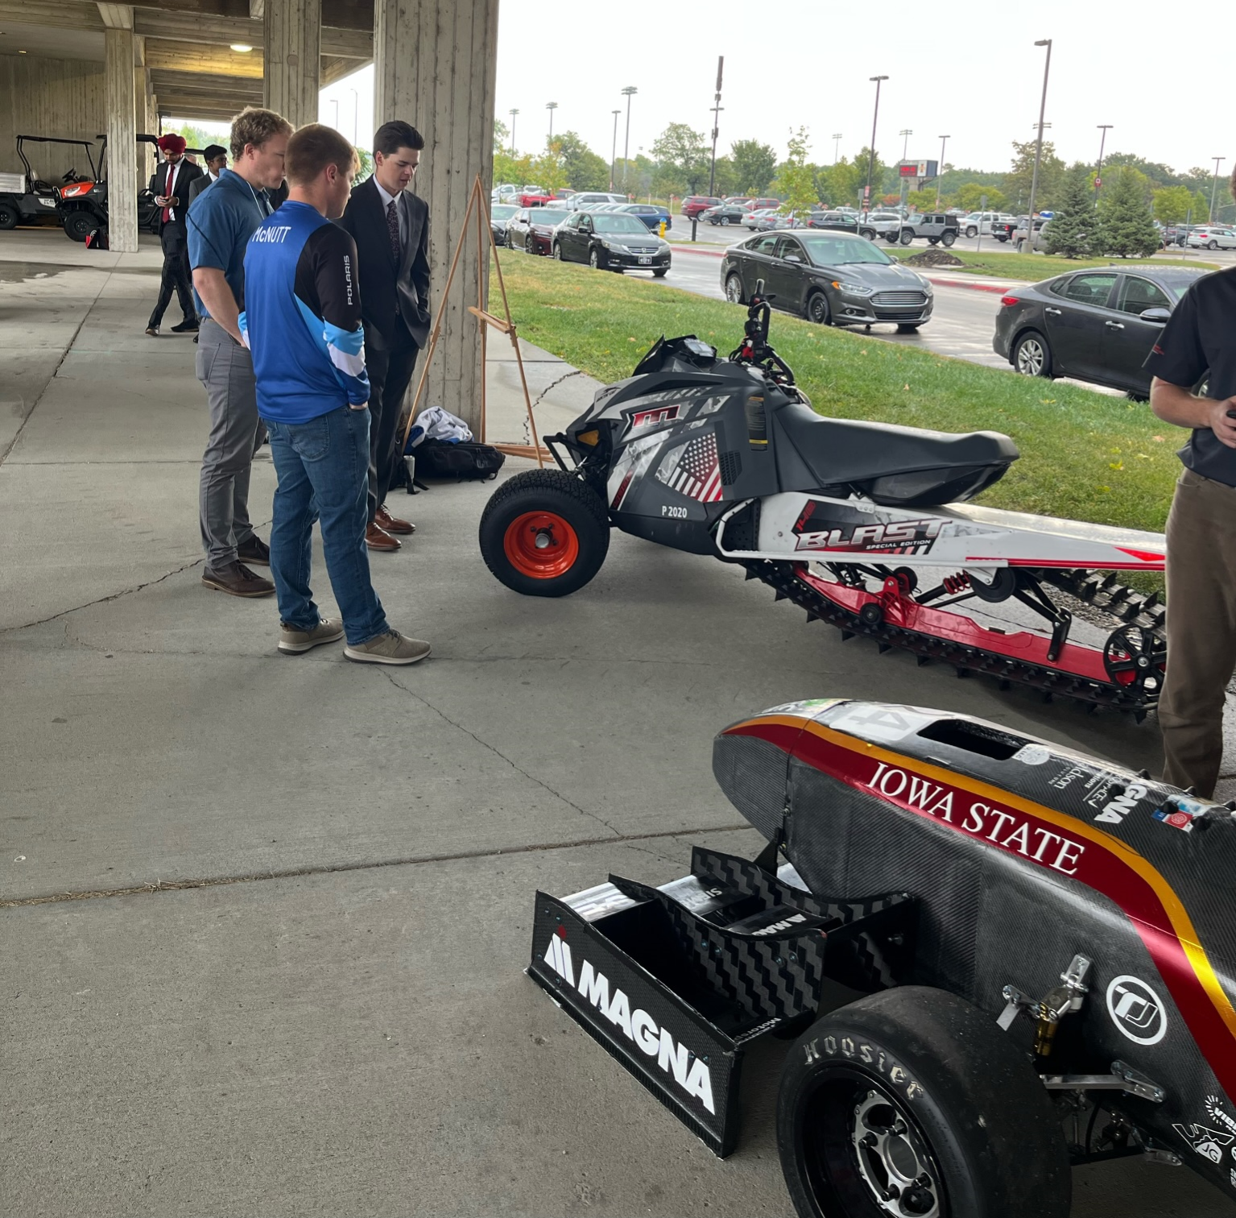
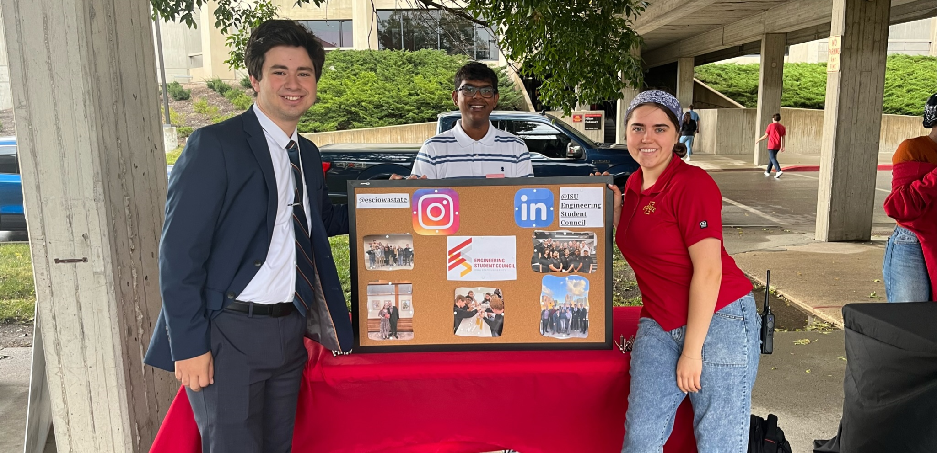
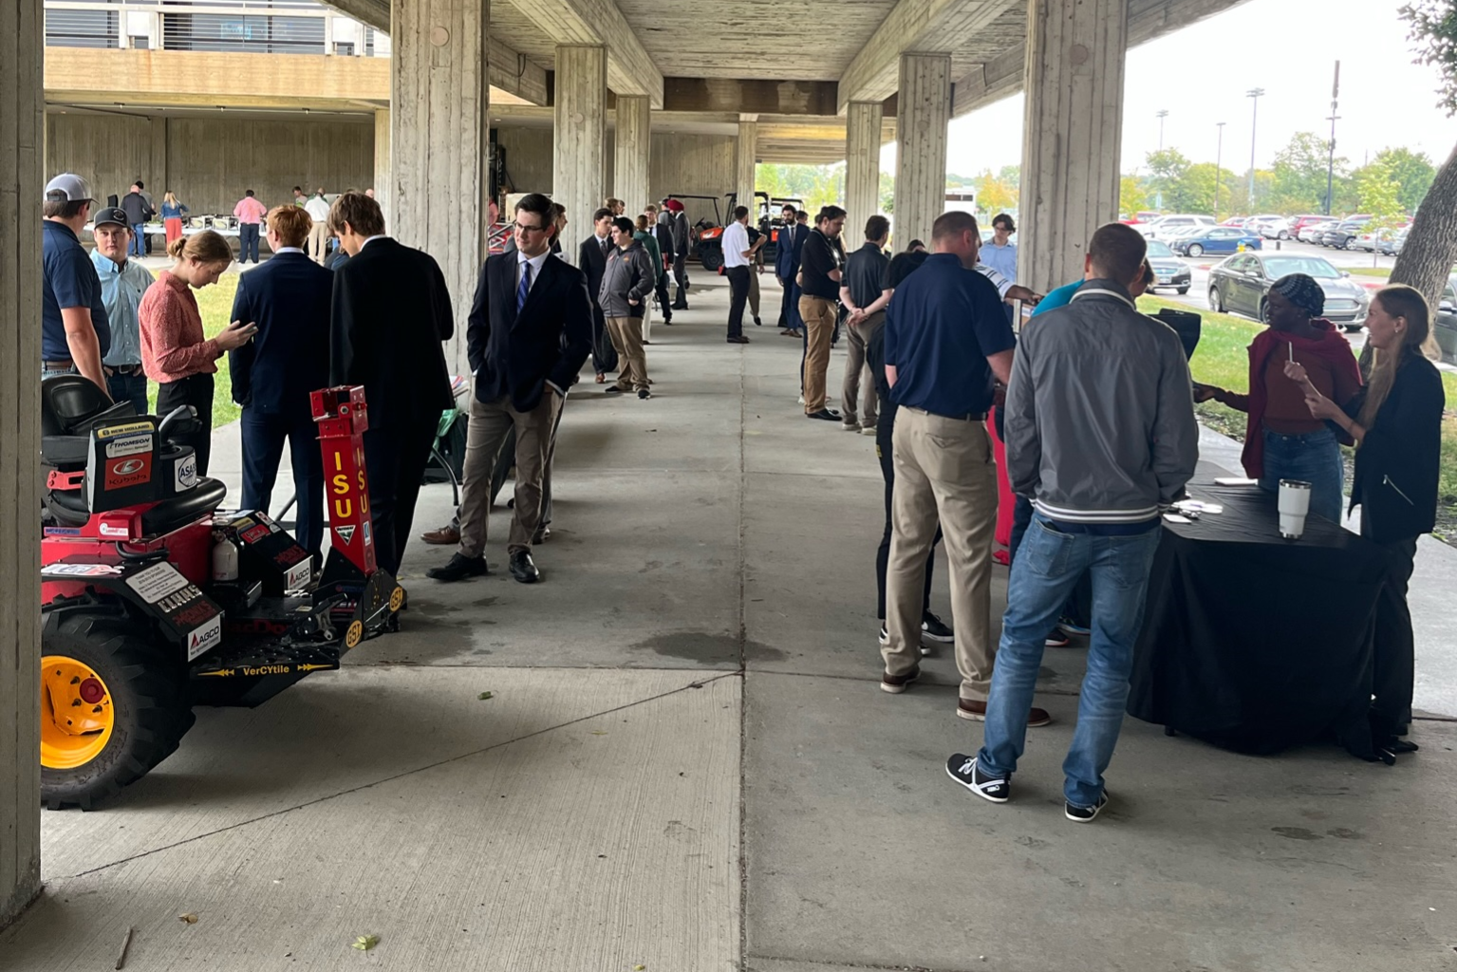
Co-Presidents
Rachel Schnepf & Victoria Kyveryga
rschnepf@iastate.edu & vkyveryg@iastate.edu
isu.esc.presidents@gmail.com
Office hours Mondays, Marston 1110, 3-4 pm
General Committee applications
Thanks for a successful Reverse Career Fair!
General meetings coming up:
Monday, October 23, 2023, 7-8 pm in Marston 2200
Monday, November 13, 2023, 7-8 pm in Hoover 1227

Slide 25
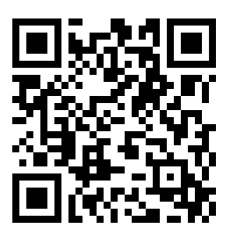
Feedback & attendance form
https://forms.gle/K7ouJzTaFTtAQ8L49
Lastly, a reminder about the email list-serve:
https://www.engineering.iastate.edu/esc/clubs/
Please make sure your club exec contact info is correct in this link^

Slide 26
Club Updates

Slide 28
Important ESC Dates
Upcoming Events:
Destination Engineering, October 4th
Next general meeting: October 23rd, 7-8 pm

Slide 29
Thank you! -

