Slide 1
Welcome to ESC!

Slide 2
Ethics Research Project
Luan M. Nguyen
nguyenl@iastate.edu

Slide 3
Welcome
Valentina Benito-Correa – Development Assistant, College of Engineering
Dana Savagian – Assistant Director of Annual and Special Gifts

Slide 4
ISU Foundation
Official charitable organization of Iowa State University
Responsible for raising private support to enhance the goals of the university
Fundraising priorities set by President Wintersteen and other university leadership
Currently the Iowa State University Foundation is on the tail end of a nine-year fundraising campaign called, Forever True, For Iowa State, to raise $1.5 billion for the university.

Slide 5
ISU Foundation & Student Organizations
Three Points of Connection
College of Engineering Development Office
ISUF Office of Corporate & Foundation Relations
ISUF Office of Annual and Special Gifts

Slide 6
Engineering Development Office
Team of 10 fundraising professionals focused on major gifts ($50,000+) in support of the College of Engineering
Major gifting conversations and strategies with individuals and corporations. ($10,000+)
Fundraising campaign strategies and supporting document messaging. Donor cultivation and stewardship strategy.
Provide names of speakers for club meetings. This office often hosts alumni on campus.
Contact Valentina Benito-Correa: vbenito@iastate.edu; (515) 294-4921

Slide 7
Corporate & Foundation Relations
Manages the comprehensive relationships that companies have with ISU
Any contact or solicitation from a student organization to a company/foundation needs to be approved by this office.
Fill out a corporate contact request form on the student activities center website to be signed by the student organization’s faculty advisor. Fill out annually if a new solicitation comes up.
Provide the ISU Foundation a list of companies that the student organization would like to solicit along with a copy of the solicitation letter and/or sponsorship packet.
Recording gifts in kind – extremely important for getting matching funds from the College of Engineering (Student Innovation Equipment)
Contact Sara Sales: sjsales@foundation.iastate.edu; (515) 294-7299

Slide 9
Annual & Special Gifts
Alumni Solicitations & Special campaigns. This team is responsible for PhoneCenter, email and online, and mail fundraising, as well as our FundISU platform.
Identify specific audience and provide data for your fundraising efforts.
FundISU – FundISU is a crowdfunding platform to help Iowa State University community members raise money to support their passion projects.
Contact Dana Savagian: savagian@foundation.iastate.edu; (515) 294-8536

Slide 10
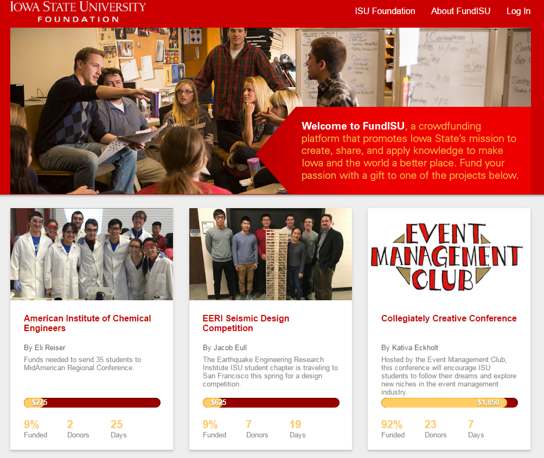
https://fundisu.foundation.iastate.edu/

Slide 11
Helpful Tips
Fundraising is student organization responsibility
Develop a fundraising plan
    Who is your target audience?
      Past members, Past member companies, Current members Co-ops and internship companies, Social media followers, Volunteers, Parents/Family, Regional/local companies, companies with ISU alums (everyone wants to go after the large corporations so think outside the box)
    How will you solicit your audience? What is your story, vision, immediate needs, etc.?
      Social media, FundISU – crowdfunding platform, College/department specific communications

Slide 12
Helpful Tips
Be conscious of timing. Don’t fundraise for a conference next week.
  Create a realistic timeline to understand needs (i.e., bus rental, airline tickets, etc.)
Create a Donor Stewardship strategy
  This will greatly help the future fundraising success of the student organization
  Regular/personalized communication. Phonecalls, thank you letters, emails, social media, etc.

Slide 13
Helpful Tips
Collect membership/volunteer data and contact information
  Extremely beneficial for future fundraising campaigns
  Share this data with the ISU Foundation (include student ID’s)
    Info can be sent to Amanda Welder: awelder@foundation.iastate.edu
  Pass down strategies during student organization leadership transition
    Transfer of knowledge is very important, it’s what helps groups that do projects multiple years be successful.
  Make sure you are recording gifts through ISU Foundation to ensure data for the future and easily gives College of Engineering view into your progress

Slide 14
Questions?

Slide 15

Outreach
First Lego League (FLL) State Event Outreach
  Saturday and Sunday (1/18/2020 & 1/19/2020)
  Event with over 4000 people, including 600 kids (x2 days)
  High Density Impact
  Activities geared towards youth (we can help!)
  Opportunity for larger presentations
  More details and resources will be coming later!
Notes:
First weekend after getting back from winter break, AND monday after is no class for martin luther king jr. holiday.

Slide 16
Trademark
Guideline Document - In process, will be posted on website
For requests, please allow approximately 3 weeks for full processing:
  ESC Sponsorship - https://forms.gle/gtPV3BygQHSkQsjLA
    Only need one submission per semester
  Requests - https://forms.gle/Z9H4mVYcLbkbaDQJ8
    Submissions needed per item
  Questions - njkline@iastate.edu

Slide 17
Allocations
25 Clubs Requested Funds
    Should have receipts done by tomorrow.
    Transfers will be done as soon as possible.
    If you have any questions, reach out to Josh at isu.esc.finance@gmail.com.
Spring Allocations will be in January. Watch for emails towards the end of this semester for details.

Slide 18
Announcements
StuGov Engineering Senators open forum - Oct. 24, 6pm (location TBD)
E-Week Trivia Night - Nov. 3, 8-9pm (Marston 2200)
Order of the Engineer - Dec. 2 (Lee Liu Auditorium)
  Ceremony for graduating seniors to swear to be ethical engineers.
Dead Week Breakfast
  Tuesday, Dec. 10, 10p-midnight (Howe Atrium )
Club Showcase: Suggestions for next year? Fill out this survey: https://forms.gle/wUYnNcfKzek5aC2A9

Slide 19
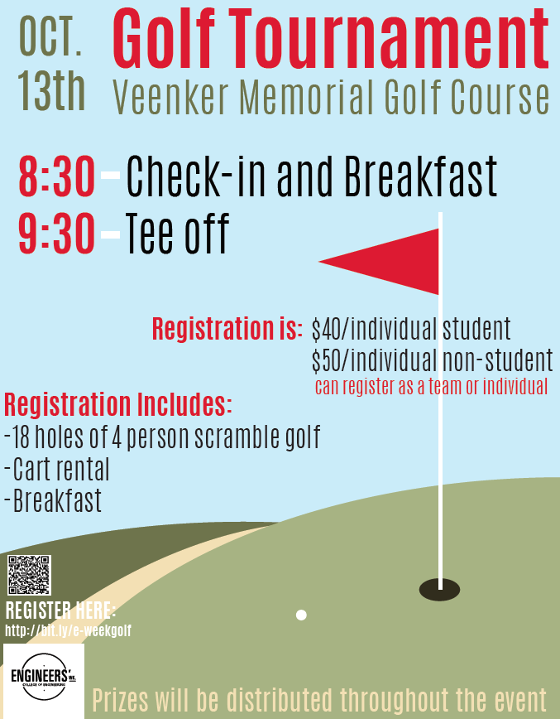
Follow ESC on Social Media
  Instagram @esciowastate
  Twitter @esciowastate
  Facebook ESCatISU

Slide 20
Presidents
Make sure to sign in on the iPad.
Office Hours: Fridays from 11a-12p in 1200 Marston
These slides can be found on our website shortly!
https://www.engineering.iastate.edu/esc/

